Slide 1
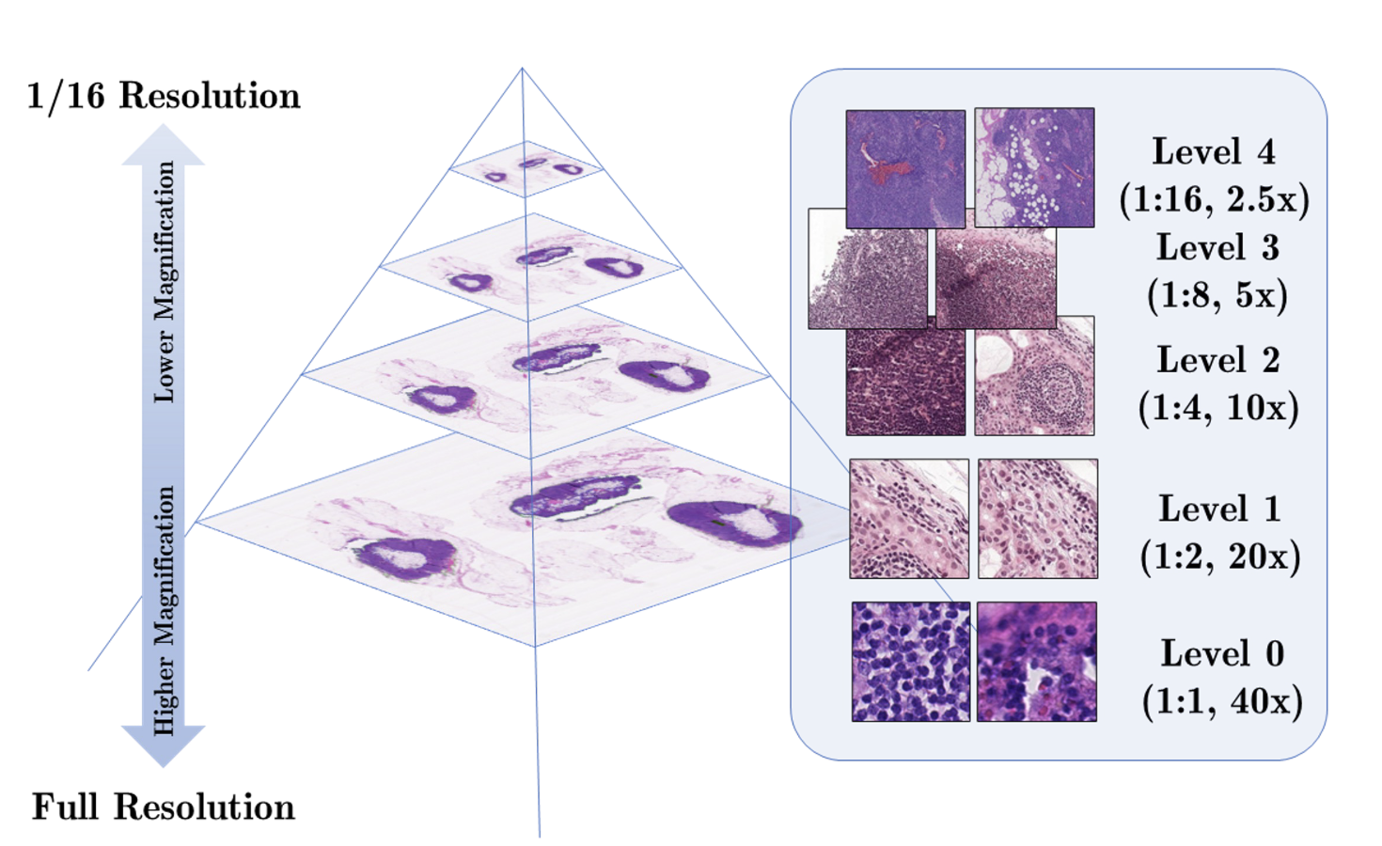
What is a WSI?
Definition: Scanning a complete microscope slide to create a single high-resolution digital file.
Process: Capturing many small high-resolution image tiles and montaging them to create a full image.
Impact: Transforming laboratory workflows by enabling efficient storage, access, analysis, and sharing of digital slides.

Slide 2
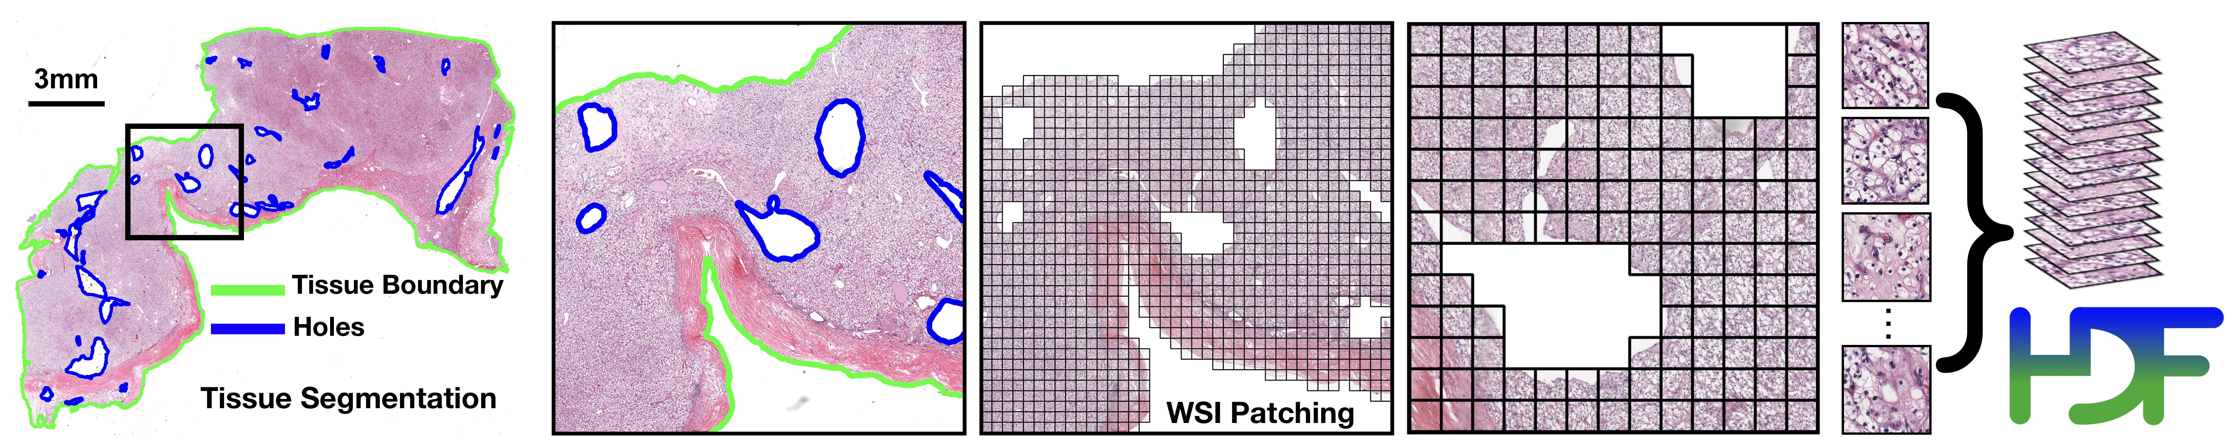
CLAM
Capability: CLAM is a high-throughput and interpretable method for data efficient whole slide image (WSI) classification.
Advantage: CLAM can handle multi-class subtyping problems and adapt to independent test cohorts of WSI resections and biopsies as well as smartphone microscopy images.
Feature: CLAM does not require any ROI extraction or patch-level annotations.

Slide 3
How CLAM works?
Method Type: Deep-learning-based weakly-supervised method.
Purpose: Accurately classify whole slides by identifying sub-regions of high diagnostic value.
Key Technique: Attention-based learning and instance-level clustering.

Slide 4
How we integrated CLAM in our work
CLAM Integration: Integrated CLAM for image preprocessing, specifically extracting patches from TIF or SVS files.
CLAM Output: Generates three directories (masks, patches, stitches) and a CSV file containing metadata and variables used for patch creation.
Patch Format: Patches are stored in H5 format and converted to JPG for usability.

Slide 5
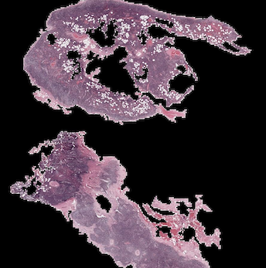
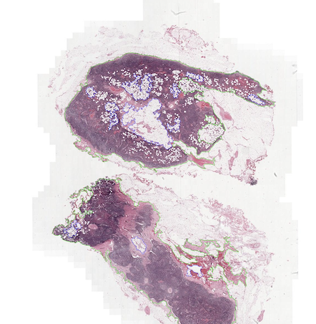
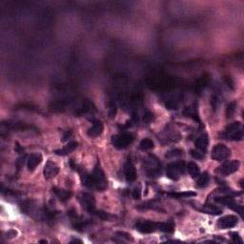
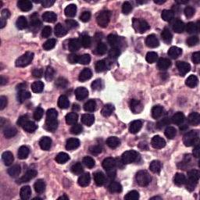
Some examples
Starting from the slide, CLAM generates the stitches, masks and patches

Slide 6
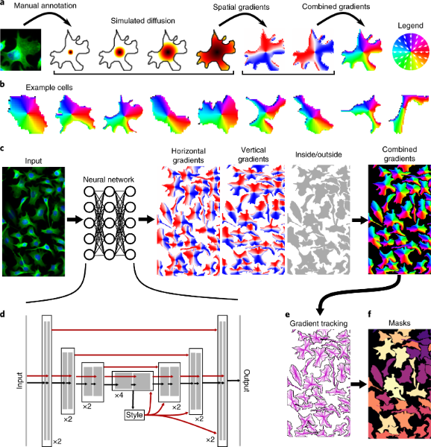
What is Cellpose?

